Slide 1

FACTORY OUTLET STORE
Made By:- Guided By:-
Jyoti Jhanwar Deepak sir

Slide 2
OVERVIEW
Online shopping is a process whereby consumers directly buy goods, services etc. from a seller without an intermediary service over the Internet. ... Online stores are usually available 24 hours a day and many consumers have internet access both at work and at home. So it is very convenient for them to shop Online.

Slide 3
Hard Ware Requirements
Pentium IV System with 2.8 GHZ Processor
1GB RAM
40 GB Hard Disk

Slide 4
Software Requirement Specification
Operating System-Windows 10
Browser- Google Chorme
Data base-Ms SQL

Slide 5
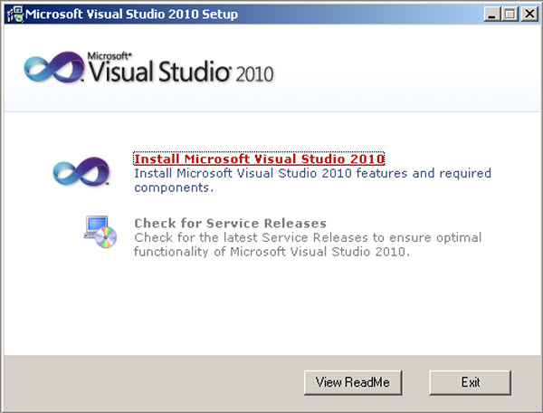

Slide 6
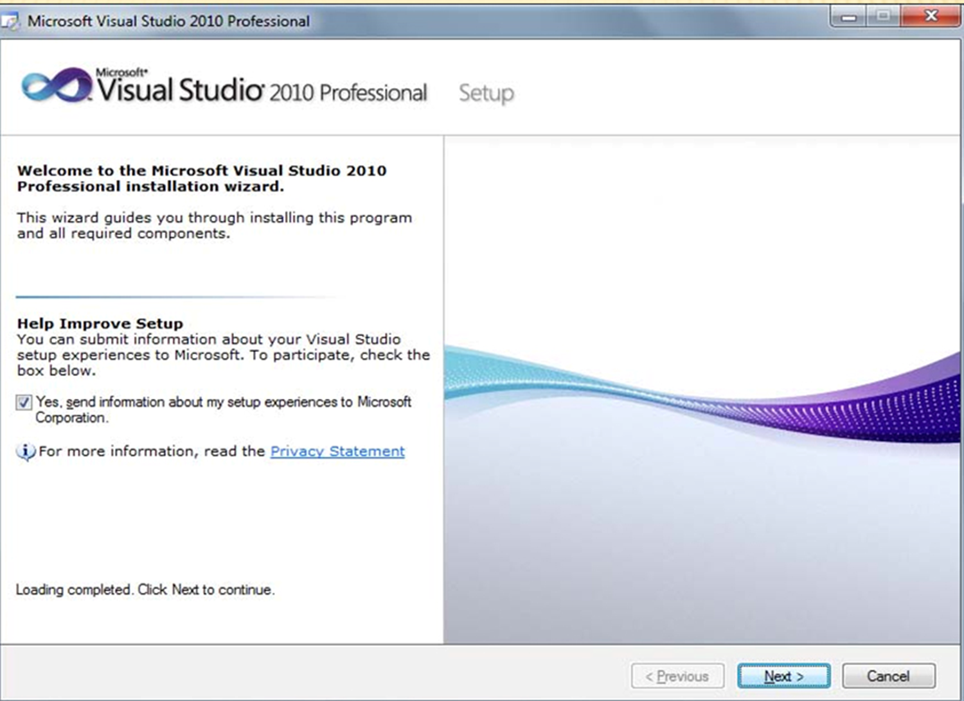

Slide 7
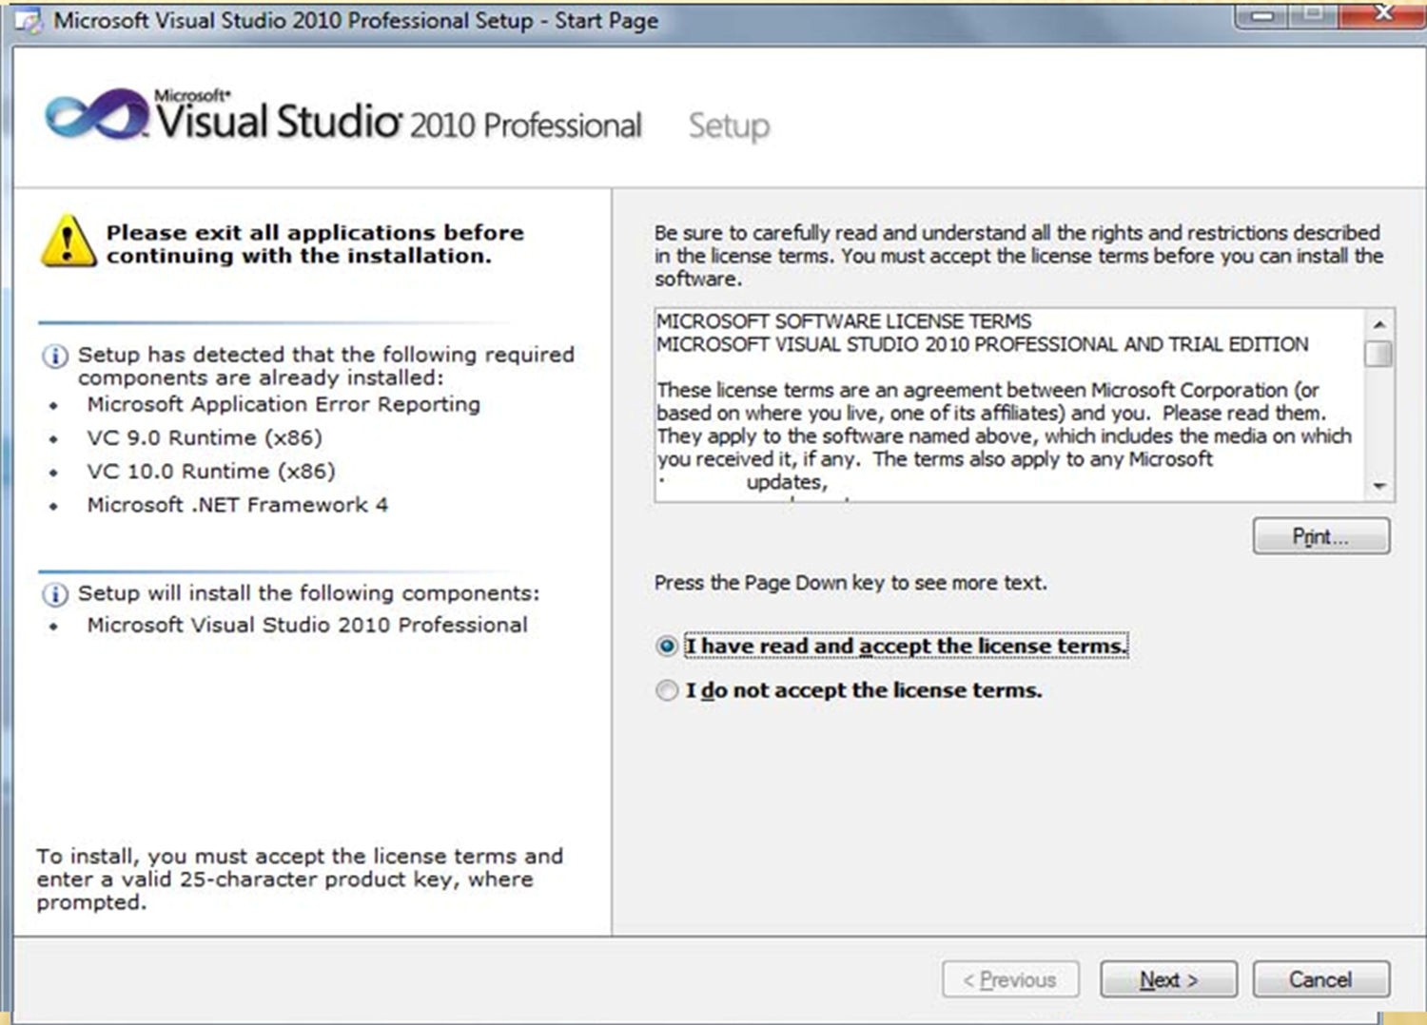

Slide 8
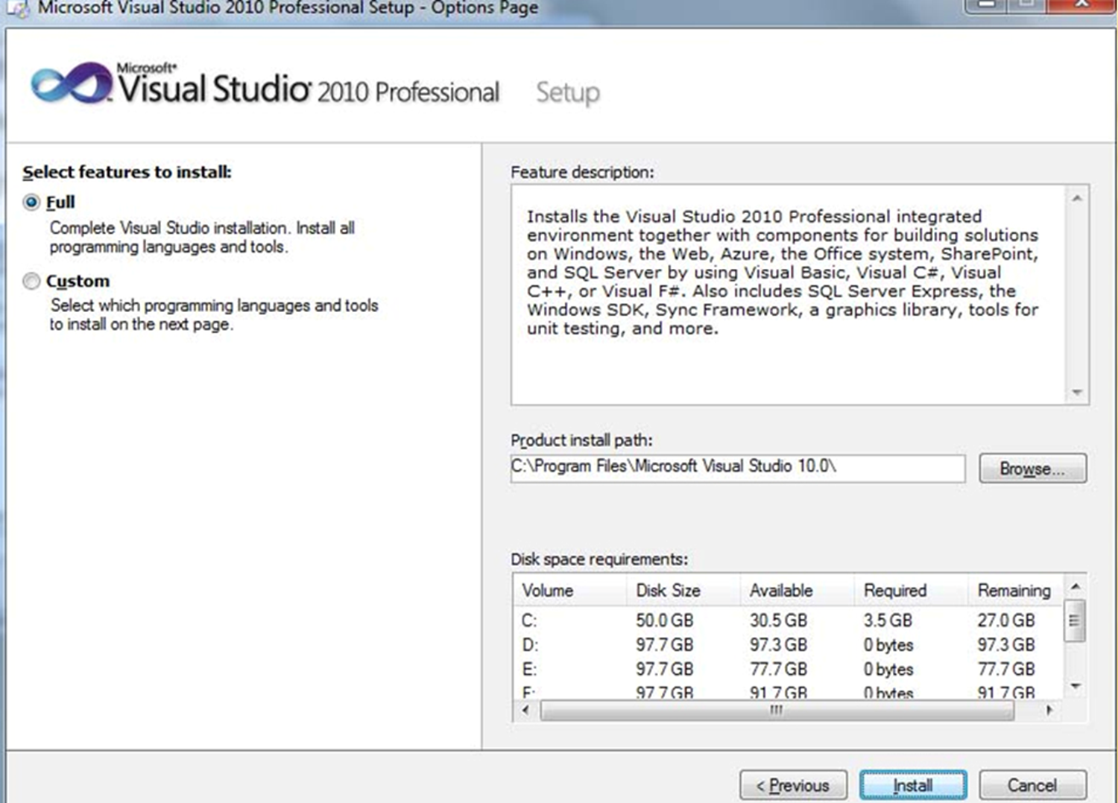

Slide 9
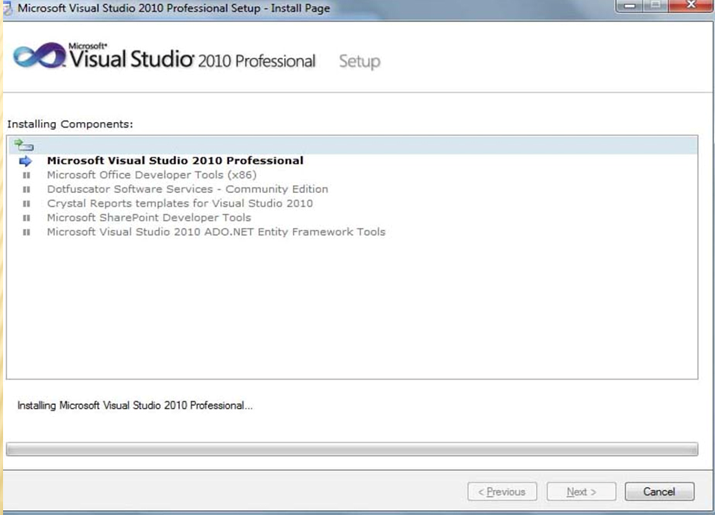

Slide 10
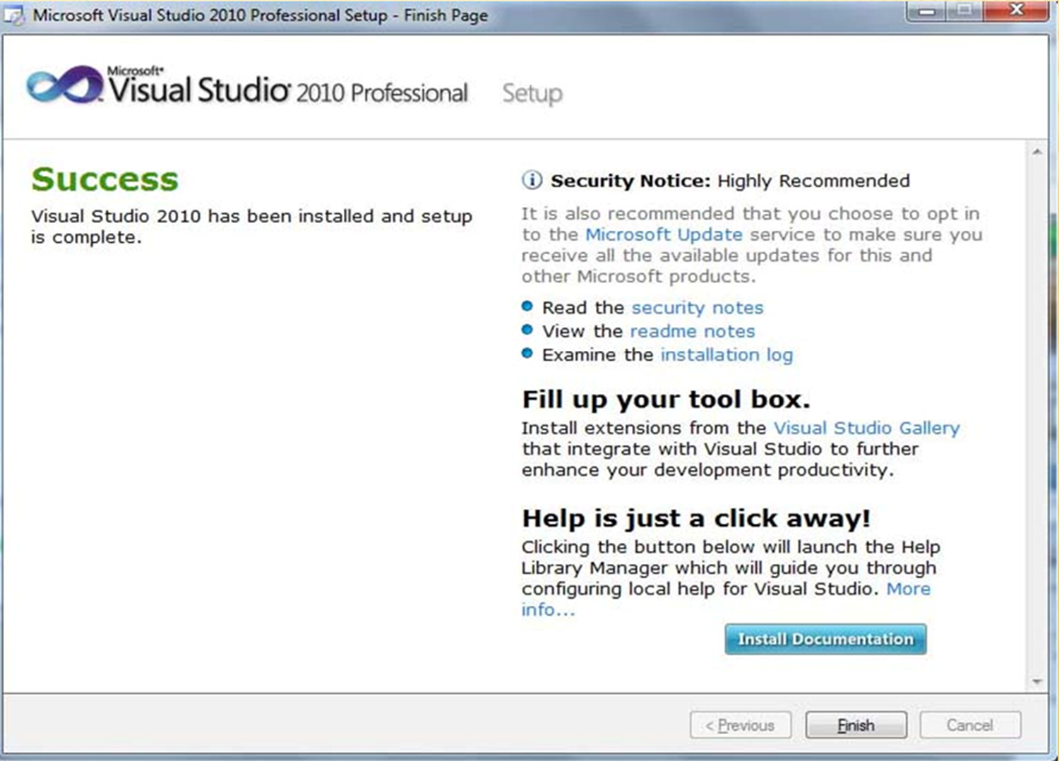

Slide 11


Slide 12
USER PANEL INTERFACE

Slide 13

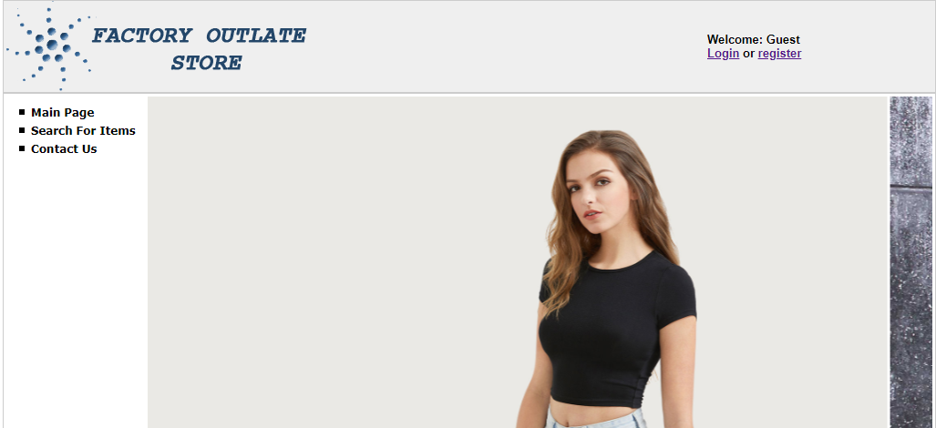
HOME PAGE:-

Slide 14

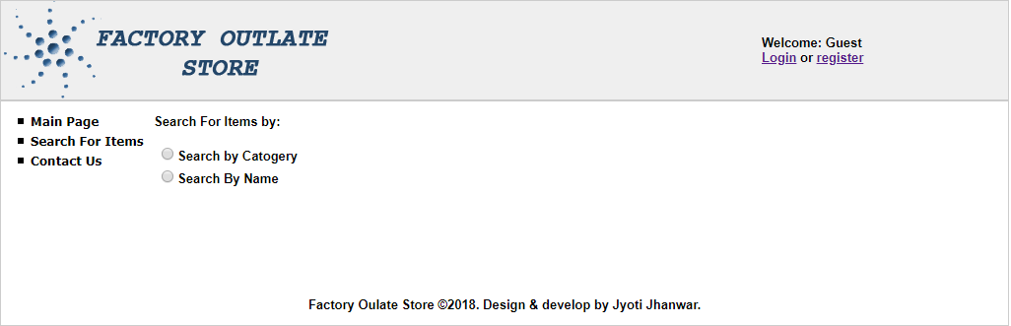
Search For Items

Slide 15
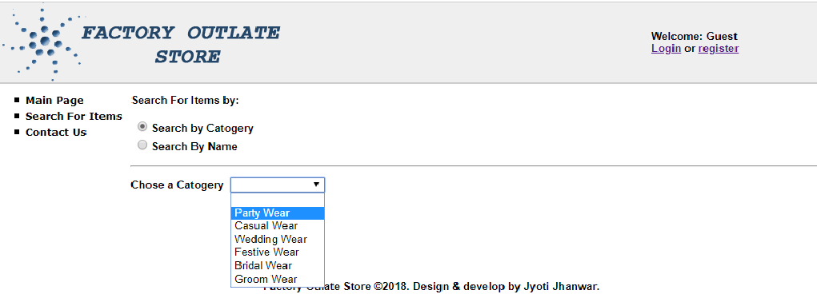
Search by Catogery

Slide 16
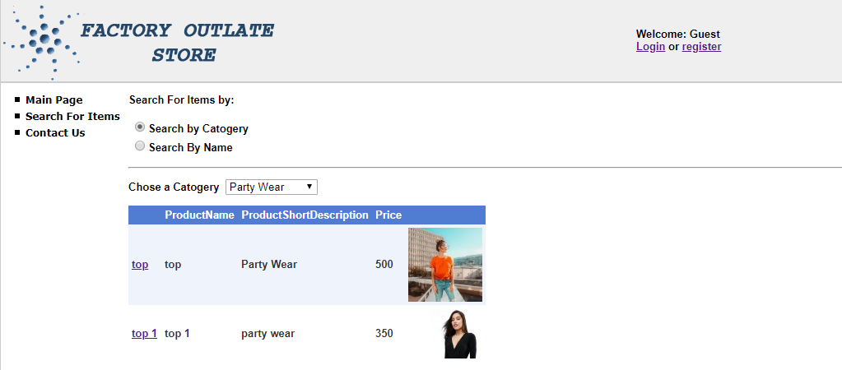
Party Wear

Slide 17
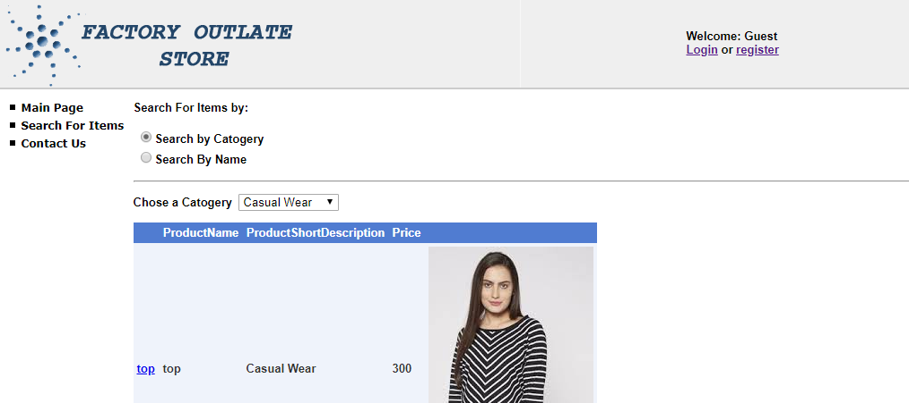
Casual Wear

Slide 18
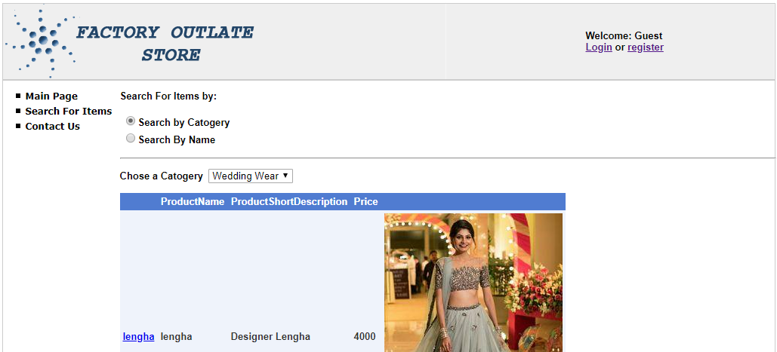
Wedding wear

Slide 19
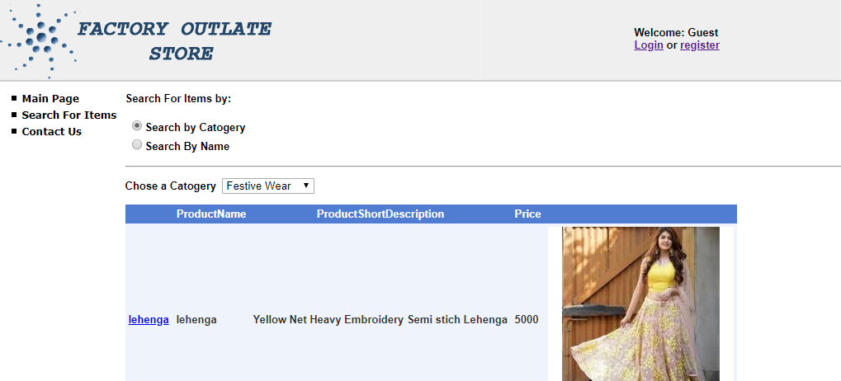
Festive Wear

Slide 20
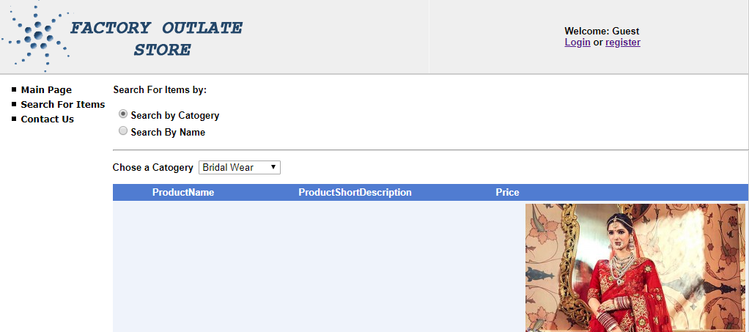
Bridal wear

Slide 21
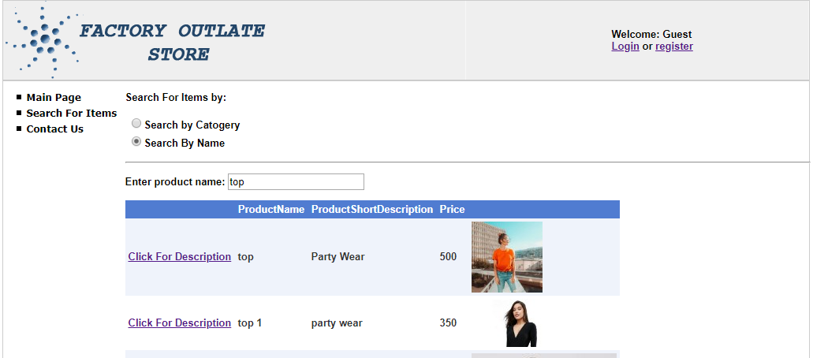
Search By Name

Slide 22

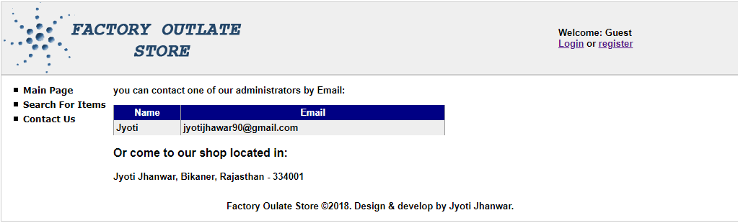
Contact Us

Slide 23

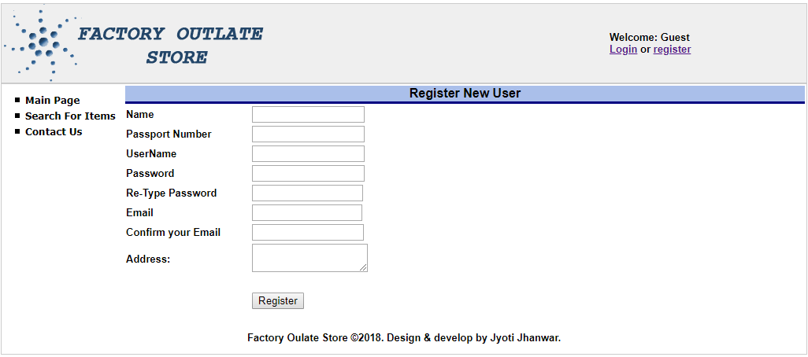
Register new user

Slide 24
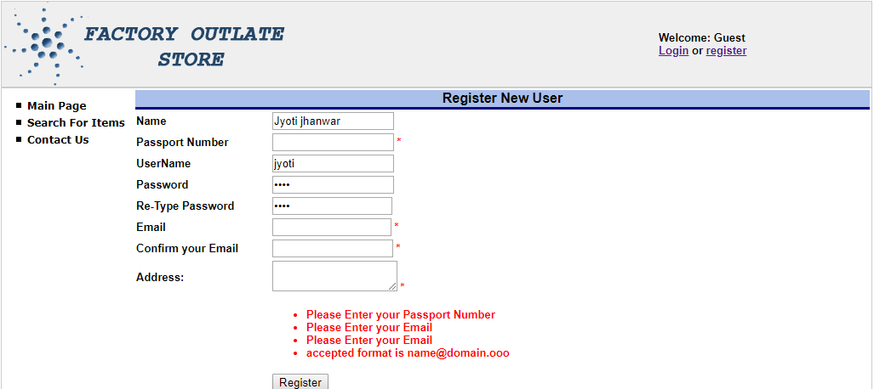
Register new user

Slide 25
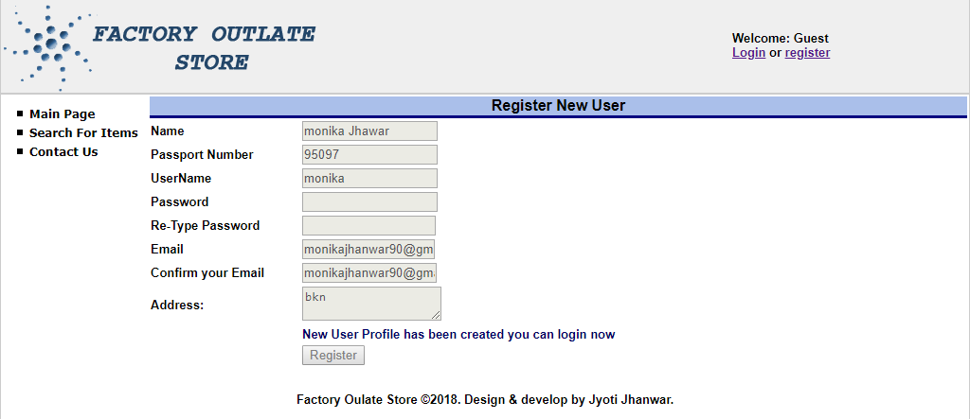
Register new user

Slide 26

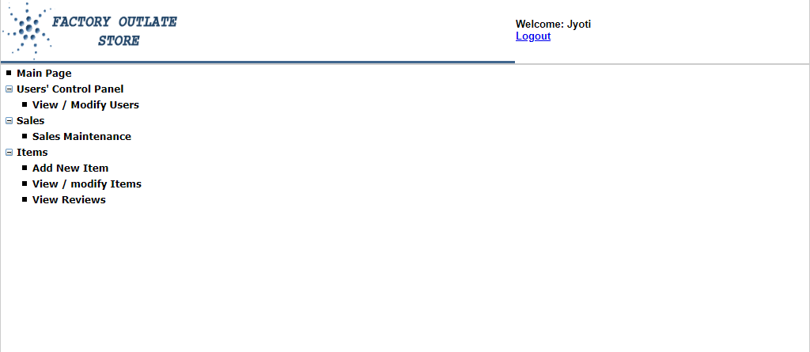

Slide 27

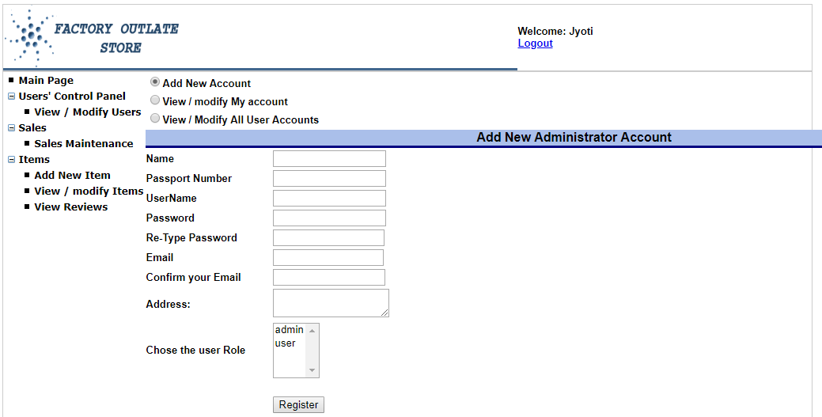
Add new Account

Slide 28
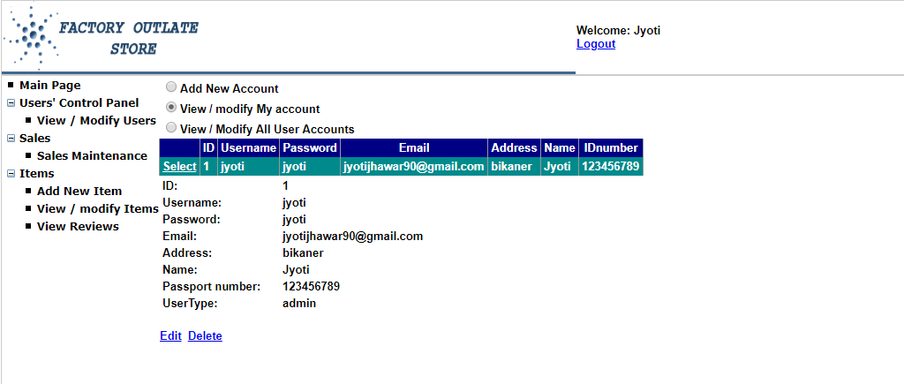
View/Modify my Account

Slide 29
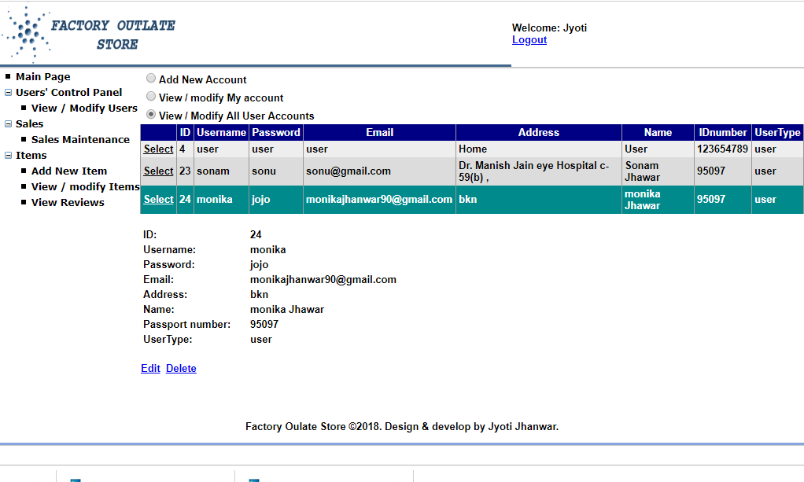
View/Modify All user Account

Slide 30

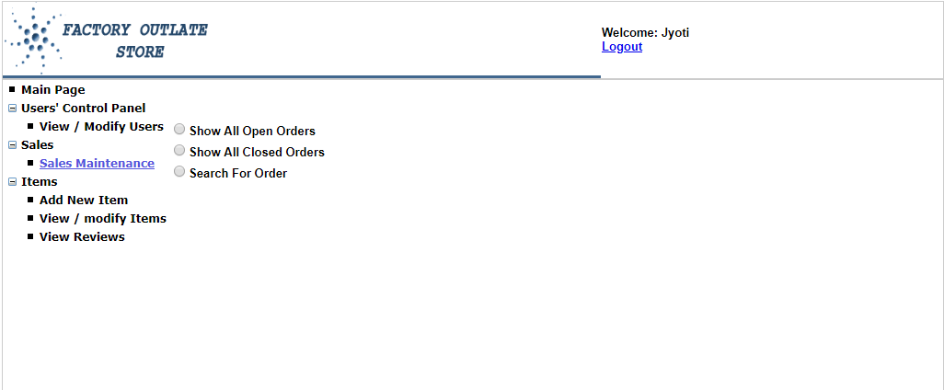
Sales maintenance

Slide 31
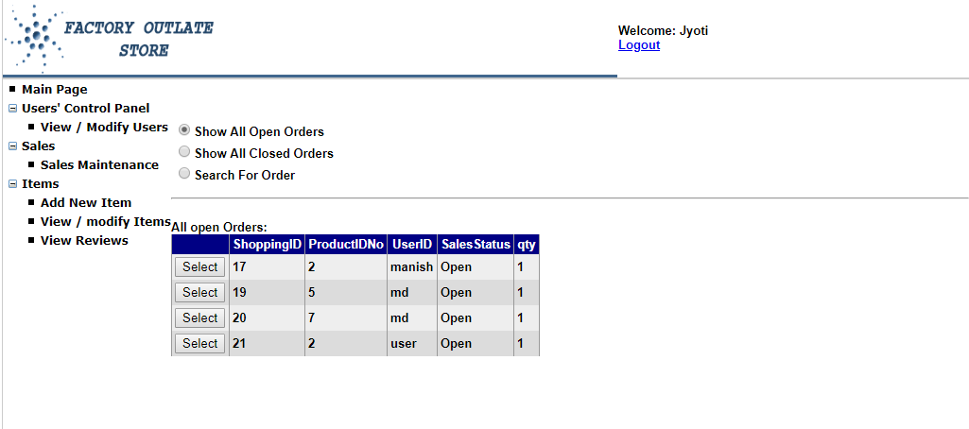
Show all Open Orders

Slide 32
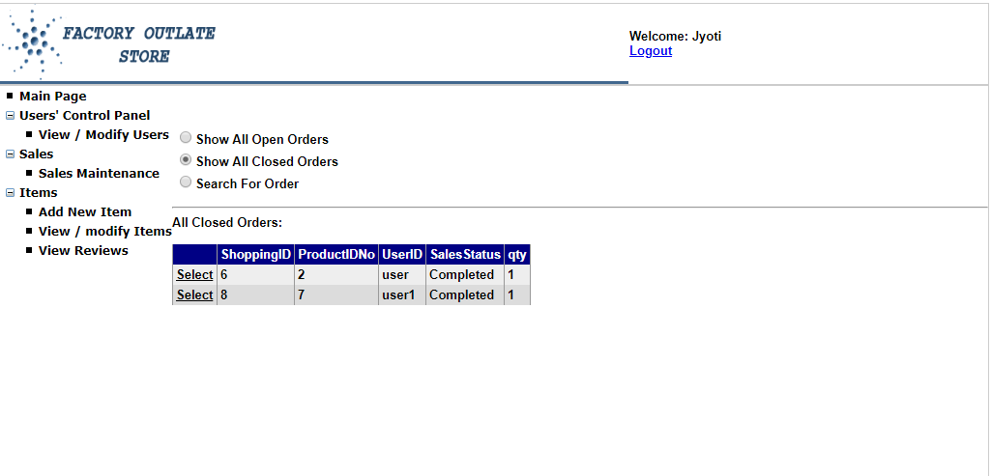
Show all Closed Orders

Slide 33
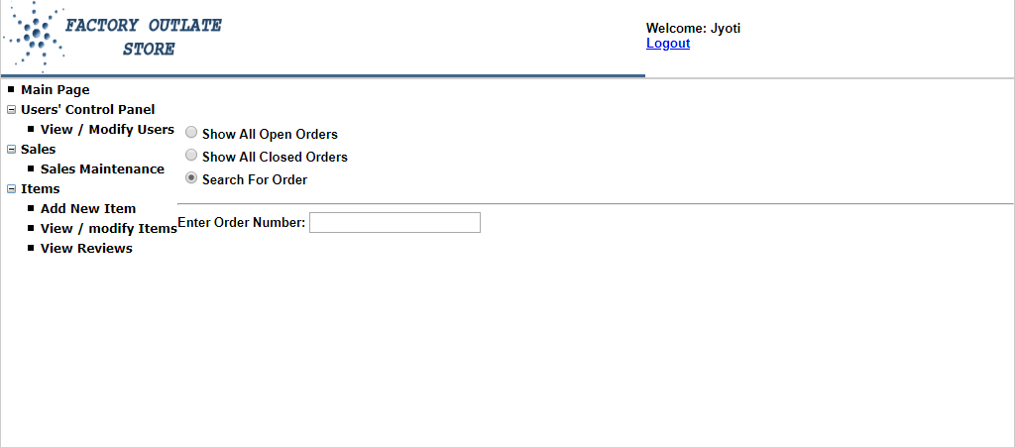
Search for Orders

Slide 34

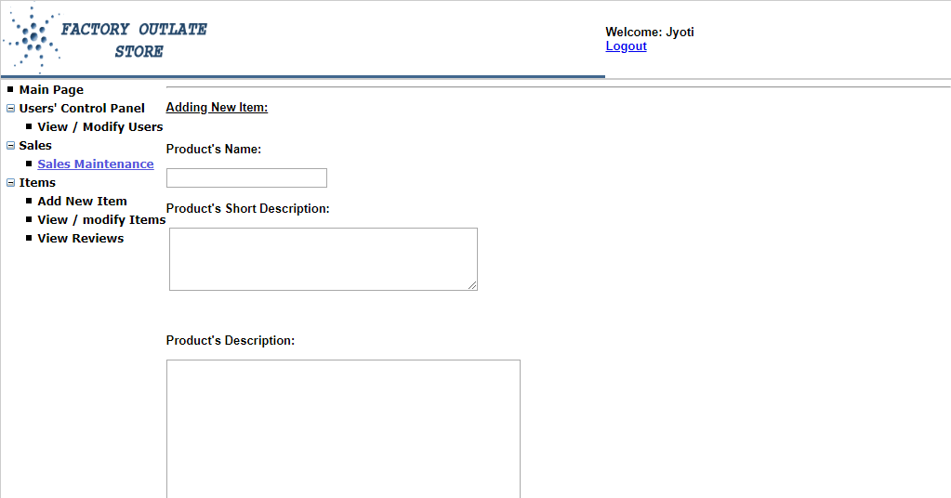
Add new Item

Slide 35
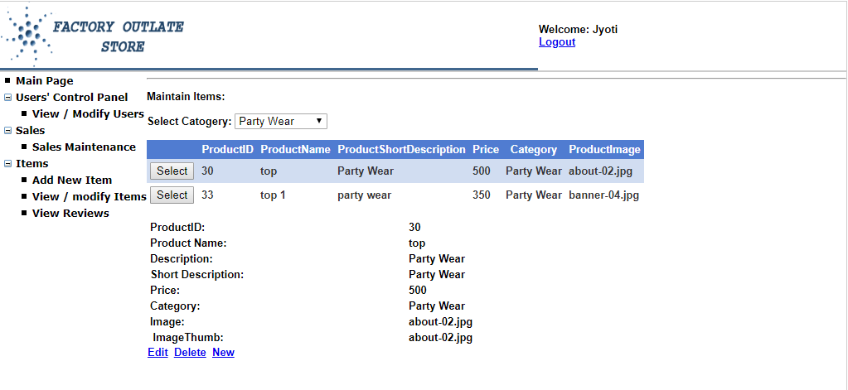
View/modify Items

Slide 36
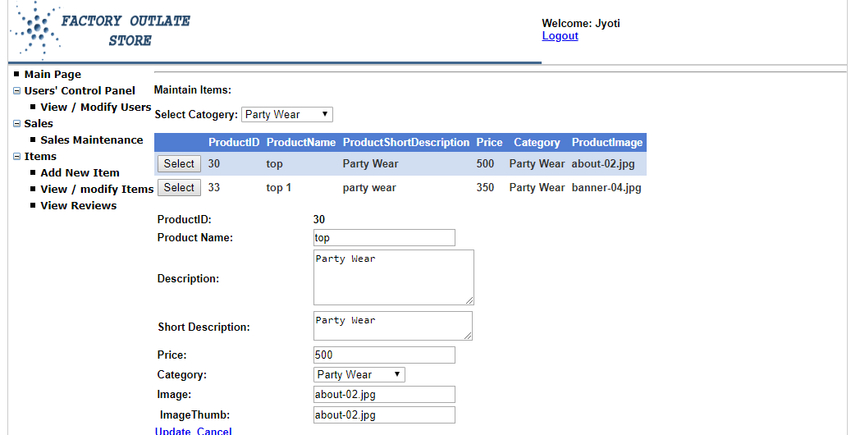
View/modify Items

Slide 37


